Slide 1
Your DB in the cloud?
Shawn Weisfeld
shawn@shawnweisfeld.com
http://www.shawnweisfeld.com

Slide 2







About Me
Founder of UserGroup.tv
Azure Technical Evangelist at Microsoft
MCSD: Azure Solutions Architect

Slide 3


Watch User Group presentations for FREE online!
All the topics you care about
Including:
Agile
C#
Entity Framework
HTML5
MVC
Silverlight
XAML
jQuery
and Much More!
Miss a User Group meeting?
Forget something that you learned?
Want to see content from a User Group not in your area?
Want to share with a buddy?
We know you cannot make it to every User Group meeting,
that is why we post them online for you!
We now have over 425 presentations online
That is over 100 GB of video
New Content added all the time!
Presentations from the thought leaders on the topic.
For new content announcements
@UserGroupTV
http://www.UserGroup.tv

Slide 4
Agenda
Why the cloud?
IaaS vs PaaS
IaaS in Azure
PaaS in Azure
Hybrid
Futures

Slide 5
Why the cloud?
How long does it take you to provision a new VM?
DR?
Security?
Power?
Network connection?
Compliance?
…

Slide 6
So I have sold you on moving to Azure! Now what?

Slide 7
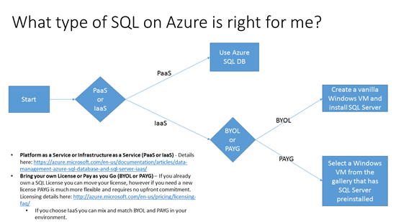
More details at:
http://blogs.msdn.com/b/azuregov/archive/2015/08/31/what-type-of-sql-on-azure-is-right-for-me.aspx

Slide 8
IaaS vs PaaS

Slide 9
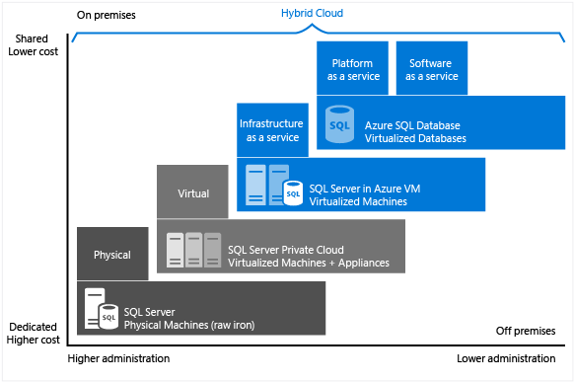
Azure SQL Database and SQL Server in Azure VMs
Details @ https://azure.microsoft.com/en-us/documentation/articles/data-management-azure-sql-database-and-sql-server-iaas/

Slide 10


Who is going to maintain it?
Packaged Software
Infrastructure
(as a Service)
Platform
(as a Service)
Software
(as a Service)
You manage
Applications
Applications
Applications
Applications
Data
You manage
Data
Data
Data
Runtime
Runtime
Runtime
Runtime
Managed by vendor
You manage
Middleware
Middleware
Middleware
Managed by vendor
Middleware
O/S
O/S
O/S
O/S
Virtualization
Virtualization
Managed by vendor
Virtualization
Virtualization
Servers
Servers
Servers
Servers
Storage
Storage
Storage
Storage
Networking
Networking
Networking
Networking
Your Car
Rental Car
Taxi
Kit Car

Slide 11
IaaS vs. PaaS
With IaaS you own
Patching of the Guest OS
Patching of installed software
High Availability
Upgrades
Your software
With PaaS you own
Your software

Slide 12
Why IaaS?
Relational Engine
Very close to feature parity with v12 release
SSRS/SSAS
DB is outside the limits of current PaaS service
Quick lift & shift

Slide 13
Why PaaS?
Upgrades
High Availability
Disaster Recovery
Point in Time Restore
Compliance
Scale Out (via Elastic Scale)
Licensing
Details @ http://blogs.msdn.com/b/igorpag/archive/2015/03/20/azure-sqldb-and-sql-server-vm-how-to-make-an-equal-cost-comparison.aspx

Slide 14
IaaS

Slide 15
Licensing Models
BYOL
Create a vanilla Windows VM install SQL Server just like you do today.
Reuse already purchased SQL SA licenses
Pay by the Minute
Use preconfigured SQL Windows VM, no need to install
Pay for what you use, add/remove capacity without long term commitments
You can mix and match

Slide 16
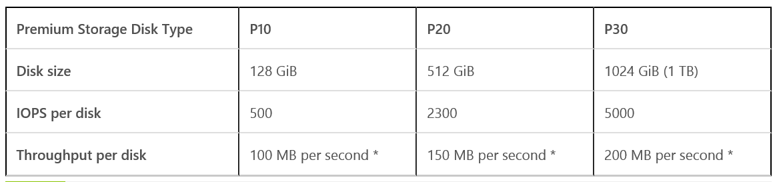
Picking the right VM
How much RAM/CPU do you need?
How much IOPS do you need?
Standard storage up to 500 IOPS per disk
i.e. D14 w/ 32 disks striped -> up to 16,000 IOPS
Premium storage up to 5,000 IOPS per disk (requires DS Series VMs)
Shard workload to reduce demands on a single server (more info soon)
Details @ https://azure.microsoft.com/en-us/documentation/articles/virtual-machines-size-specs/

Slide 17
PaaS

Slide 18

Azure SQL Database
Fully managed SQL database service so you can focus on your business
Built for SaaS and Enterprise applications
Predictable performance & Pricing
Elastic database pool for unpredictable SaaS workloads
99.99% availability built-in
Geo-replication and restore services for data protection
Secure and compliant for your sensitive data
Fully compatible with SQL Server 2014 databases

Slide 19
A single customer creates DBs
Single customer application with DB
Use of Azure SQL DB
60k / every week
114 k
133countries
Logins
Database in use
Database hours
350 M / everyday
1.4 M / as of today
20 M / per day

Slide 20
Database Service Tiers
Basic
Standard
Premium
Intended Use
Light transactional workloads
Go-to option for most business applications
High throughput and business-critical databases
Performance
•
••
•••
Workload Elasticity
Isolated databases and elastic database pools
Programming Surface
Fully compatible with SQL Server 2014 databases
Availability
99.99%*

Slide 21
Service Tiers
 | Basic | Standard | Premium
Database Throughput Units (DTUs) | 5 | 10 - 100 | 125 - 1750
Maximum Database Size | 2 GB | 250 GB | 500 GB – 1 TB
Point-in-time Restore (PITR) | Up to millisecond within last 7 days | Up to millisecond within last 14 days | Up to millisecond within last 35 days
Disaster Recovery | Geo-Restore, restore to any Azure region | Standard geo-replication, 1 offline secondary | Active geo-replication, up to 4 online readable secondaries
Performance Objectives | Transaction rate per hour | Transaction rate per minute | Transaction rate per second

Slide 22
Service Tiers
Service Tier | DTU | MAX DB Size | Max Concurrent Requests | Max Concurrent Logins | Max Sessions | Benchmark Transaction Rate | Predictability | Est. Price per Month
Basic | 5 | 2 GB | 30 | 30 | 300 | 16,600 t/p hour | Good | $5
Standard/S0 | 10 | 250 GB | 60 | 60 | 600 | 521 t/p minute | Better | $15
Standard/S1 | 20 | 250 GB | 90 | 90 | 900 | 934 t/p minute | Better | $30
Standard/S2 | 50 | 250 GB | 120 | 120 | 1,200 | 2,570 t/p minute | Better | $75
Standard/S3 | 100 | 250 GB | 200 | 200 | 2,400 | 5,100 t/p minute | Better | $150
Premium/P1 | 125 | 500 GB | 200 | 200 | 2,400 | 105 t/p second | Best | $465
Premium/P2 | 250 | 500 GB | 400 | 400 | 4,800 | 228 t/p second | Best | $930
Premium/P6 (formerly P3) | 1,000 | 500 GB | 1,600 | 1,600 | 19,200 | 735 t/p second | Best | $3,720
Premium/P11 | 1,750 | 1 TB |  |  |  |  | Best | $7,001
http://azure.microsoft.com/en-us/pricing/details/sql-database/
https://msdn.microsoft.com/en-us/library/azure/dn741336.aspx

Slide 23
Database Performance and Throughput
Compute
DTU database throughput unit
Writes
Reads
Memory

Slide 24
Predictable Performance
Basic, Standard, and Premium provide increasing performance levels
Scale individual databases up/down via portal, PS, APIs, or T-SQL to reflect actual or anticipated demand
Database remains online while scaling
Hourly billing provides cost efficiency
P3
P2
P1
S3
S2
S0
S1
B
DTUs
5
10
20
50
100
125
250
1000

Slide 25
Azure SQL Database V12
Better support for large databases
Table partitioning + parallel queries
Online + large index rebuild
No transaction size limit
Expanded programming surface area
CLR, Full-Text Search, Change tracking, heaps, analytics, extended properties…
Deeper database insights
Full set of dynamic management views (DMV)
Greater premium performance
In-memory Columnstore
SSD based IO
SQL DB
V12

Slide 26
Data Protection
Regional Disaster Protection
Geo-Restore | Geo-Redundant Backups | RPO < 1 hour | Recovery Time Minutes to Hours
Geo-Replication | Asynchronous Replication | RPO < 5 seconds | Recovery Time < 30 seconds
Oops Recovery
Point in time restore | Continuous backup | Restore to any-point | Recovery Time Minutes to Hours
Accidental Database deletion | Tail-end backup | Restore to point of deletion | Recovery Time Minutes to Hours

Slide 27
Database Scaling

Slide 28
Canonical Cloud Application Architecture
Classic 3-tier enterprise architecture
Requires to scale to 10,000s users and process TBs of relational data
Scaling out (and in, elastically) web and worker roles is relatively easy
But, how do you scale your data tier?

Slide 29
Service Tiers
Service Tier | DTU | MAX DB Size | Max Concurrent Requests | Max Concurrent Logins | Max Sessions | Benchmark Transaction Rate | Predictability | Est. Price per Month
Basic | 5 | 2 GB | 30 | 30 | 300 | 16,600 t/p hour | Good | $5
Standard/S0 | 10 | 250 GB | 60 | 60 | 600 | 521 t/p minute | Better | $15
Standard/S1 | 20 | 250 GB | 90 | 90 | 900 | 934 t/p minute | Better | $30
Standard/S2 | 50 | 250 GB | 120 | 120 | 1,200 | 2,570 t/p minute | Better | $75
Standard/S3 | 100 | 250 GB | 200 | 200 | 2,400 | 5,100 t/p minute | Better | $150
Premium/P1 | 125 | 500 GB | 200 | 200 | 2,400 | 105 t/p second | Best | $465
Premium/P2 | 250 | 500 GB | 400 | 400 | 4,800 | 228 t/p second | Best | $930
Premium/P6 (formerly P3) | 1,000 | 500 GB | 1,600 | 1,600 | 19,200 | 735 t/p second | Best | $3,720
http://azure.microsoft.com/en-us/pricing/details/sql-database/
https://msdn.microsoft.com/en-us/library/azure/dn741336.aspx

Slide 30
Scaling your Database in Azure DB
Increase Efficiency
Add Capacity
Traditional performance tuning
Optimize physical design of your databases
Rewrite queries for better performance
Optimize database round-trips by leveraging batching
Improving network performance by using compression over the wire
And many more…
This only works up to a point, though
Cloud apps can go viral and face unprecedented scale needs
Multi-tenant ISVs and SaaS providers rely on unlimited elastic capacity in the cloud
“Easy” on premise:
Add CPUs, memory, disks to your database server
Buy a larger machine
Hard in the cloud:
Customer has no control over the hardware
Fixed scale unit sizes with limited number of form factors in our offerings
Now, what to do in the cloud when you are running a P6 already?

Slide 31

Common database scalability patterns
Fabrikam
Single large database
Inventory
Order
Vertically partitioned
Invoice
Root
Cust. #2
Single tenant/DB (ISVs/CSVs)
Cust. #n
Cust. #1
Root
Cust
[1,10]
Cust [11,20]
Shard #n
Multiple tenants/DB
Shard #2

Slide 32
Scalability options in Azure SQL DB
Vertical: Scale-up vs. scale-down
Change service-tiers for a given database as capacity needs fluctuate
Horizontal: Scale-out vs. scale-in
Add or remove databases as more or less capacity is needed
Premium
Premium
Standard
Standard
Scale up/down
Standard
Standard
Standard
Standard
Standard
Standard
Standard
Scale out/in

Slide 33
Capacity Planning for large OLTP workloads
Azure SQL DB Service Tiers
Predictable DTUs (Database Throughput Units) for each level (up to 1,000)
Max DB size (up to 500GB)
Important dimensions to consider
Max data volume
Percentage of “active portion” vs. entire dataset
Transactional workload of the application
Largest “data slice” to co-locate in the same transactional space (i.e. database)
Example:
9TB database
5000 DTU tx*/sec
• 100 S2 for 5000 DTUs (max size 25TB) -> ($90k / 12 months)
• 25 P2 for 5000 DTUs (max size 12.5TB) -> ($279k / 12 months) **
* DTU tx as defined in the Azure SQL Database Benchmark
** with many additional features

Slide 34
Sharding and Tenancy Models
Single-tenant per database
Single tenant per database
Each tenant’s data is stored in a different database
Better isolation of tenants as compared to multi-tenant model
Multiple tenants per database
Multiple tenants share the same database
Less isolation of tenants as compared to single tenant model
Typically more cost-effective than the single tenant model
Hybrid model
Some tenants share databases, others get their own database
E.g., premium or paying customers get their own databases, while free tier customers share databases
Temporal model
Sharding based on date/time
Most recent shard is constantly loaded with newly arriving data
New shards added when current most recent shard nears capacity
See guidance from the Azure CAT team on sharding:
MSDN: https://msdn.microsoft.com/en-us/library/azure/dn764977.aspx
DB₁
DB₂
Customer 1
Customer 2
…
Multi-tenant per database
DB₁
DB₂
Customer 1
Customer 4
…
Customer 2
Customer 5
Customer 3
Customer 6

Slide 35
Elastic Scale Introduction

Slide 36
Elastic Scale Goals
Easily develop applications that rely on sharded data models in Azure SQL DB, using tools of choice like ADO.Net and Entity Framework
Easily scale (grow or shrink) Azure SQL DB resources when needed
Easily manage operations that apply to large numbers of physical Azure DB databases.

Slide 37



Elastic Scale: Overview
Elastic Scale app
Cross-Shard Capabilities
Elastic Scale
Manage-ability
Client library
Cross-shard extensions
Cross-shard
operations
Cross-shard
operations
Application
Developer
Admin/
DevOps
shard₁
shard_{i}
shard_{j}
shard_{n}
Client library
Shard-local
operations
Shard-local
operations
…
…
…
Grow/shrink capacity
Admin/
DevOps
Note that your application needs to be shardable to benefit from Elastic Scale. If the application
does not partition well, Elastic Scale (or any other sharding approach) is likely not going to be a good fit.

Slide 38
Elastic Scale Overview
Two types of shard maps
Range: contiguous values
List: explicit values
Four types of sharding keys
INT, BIGINT, GUID, VARBINARY
Azure SQL DB
Shard Map Manager
DB₁
_{[0-100)}
DB₂
_{[100-200)}
DB₃
_{[200-300)}
DB₄
_{[300-400)}
DB₅
_{[400-500)}
DB₆
_{[500-600)}
DB_{n}
_{[n-n+100)}
. . .
Shard Set

Slide 39
Elastic Scale: Key Capabilities
Client .NET APIs
Management Services
Shard map management
Define groups of shards for your application
Manage mapping of routing keys to shards
Data dependent routing (DDR)
Route incoming requests to the correct shard, e.g., given a customer ID
Ensure correct routing as tenants move
Cache routing information for efficiency
Multi-shard query (MSQ)
Interactive processing across several shards
Same statement executed on all shards with UNION all semantics
Split/Merge (SM)
Grow or shrink capacity by adding or removing databases
Re-balance data among shards
Isolate hotspots
Shard Elasticity (SE)
Dynamically adjust scale factor of database
Trigger adjustment through policies

Slide 40

Data Dependent Routing (DDR)
Scenario: query a shard with a specific shardlet key
Shard Map Manager
Client App
DDR APIs ( )
Application
Developer
SELECT *
FROM customers
WHERE customer ID = 104
DB₁
_{[0-100)}
DB₂
_{[100-200)}
DB₃
_{[200-300)}
DB₄
_{[300-400)}
DB₅
_{[400-500)}
DB₆
_{[500-600)}
DB_{n}
_{[n-n+100)}
. . .

Slide 41
Data Dependent Routing (DDR)
// Get a routed connection for a given shardingKey
using (SqlConnection conn = ShardMap.OpenConnectionForKey(
shardingKey,
connectionString /* Credentials Only */ ,
ConnectionOptions.Validate /* Validate */ ))
{
using (SqlCommand cmd = new SqlCommand())
{
cmd.Connection = conn;
cmd.CommandText = "SELECT dbNameField, TestIntField,
TestBigIntField FROM ShardedTable";
SqlDataReader sdr = cmd.ExecuteReader();
// Now consume results from the data reader…
}
}

Slide 42
Elastic Scale Connection Opening Flow
ShardMap.OpenConnectionForKey(
104 /* Tenant ID */ ,
“…” /* Credentials Only */ ,
ConnectionOptions.Validate /* Validate */ ));
OpenConnectionForKey call with validation on
Check for shardlet key in cache
Cache miss: Fetch mapping info from GSM
Connect to shard
Validate on shard
Validation fails: Go back to cache miss
Shard Map Manager
Client App
DDR APIs
Application
Developer
Cache
GSM
[100, 200): DB2
DB₂
_{[100, 200)}
spValidate
LSM

Slide 43
Multi-shard Query (MSQ)
Scenario: execute a query across a set of shards (returns a UNION ALL result set)
Shard Map Manager
Client App
MSQ APIs ( )
Application
Developer
SELECT count(*)
FROM customers
UNION ALL result set
DB₁
_{[0-100)}
DB₂
_{[100-200)}
DB₃
_{[200-300)}
DB₄
_{[300-400)}
DB₅
_{[400-500)}
DB₆
_{[500-600)}
DB_{n}
_{[n-n+100)}
. . .

Slide 44
Multi-Shard Query (MSQ)
using (MultiShardConnection conn = new MultiShardConnection(
m_shardMap.GetShards(), MultiShardTestUtils.GetTestSqlCredential()))
{
using (MultiShardCommand cmd = conn.CreateCommand())
{
cmd.CommandText = "SELECT dbNameField, TestIntField, TestBigIntField FROM ShardedTable";
cmd.CommandType = CommandType.Text;
cmd.ExecutionPolicy = MultiShardExecutionPolicy.PartialResults;
cmd.ExecutionOptions = MultiShardExecutionOptions.IncludeShardNameColumn;
using (MultiShardDataReader sdr = cmd.ExecuteReader())
{
while (sdr.Read())
{
var dbNameField = sdr.GetString(0);
var testIntField = sdr.GetFieldValue<int>(1);
var testBigIntField = sdr.GetFieldValue<Int64>(2);
string shardIdPseudoColumn = sdr.GetFieldValue<string>(3);
}
}
}
}
“Best Effort” (off by default)
Where do I live?

Slide 45
Hybrid

Slide 46
Backup and Restore Databases to/from Windows Azure Storage
Limitless low-cost storage
Through the use of block blobs in SQL Server 2016 Community Technology Preview 2 (CTP2), you can stripe your backup set to support backup files sizes up to 12.5 TB.
Highly available storage (geographically replicated to ensure no data loss)
Off-site storage that can support disaster recovery and compliance requirements
Simplified remote backup and restore process
https://msdn.microsoft.com/en-us/library/dn606154.aspx#backup

Slide 47
Maintain Database Replicas on Windows Azure Virtual Machines
Low-cost disaster recovery solution
Transparent application failover
Available replicas to offload read workloads and backups
https://msdn.microsoft.com/en-us/library/dn606154.aspx#replica

Slide 48
Store SQL Server Data Files in Windows Azure Storage
Unlimited low-cost storage in Windows Azure Storage
Best suited for offloading historical read workloads to the cloud to support on-premises reporting applications
Facilitate disaster recovery by separating the compute and the data.
https://msdn.microsoft.com/en-us/library/dn606154.aspx#store

Slide 49
Migrate existing SQL Server databases to Windows Azure VMs
Move just the database
Move the entire VM
https://msdn.microsoft.com/en-us/library/dn606154.aspx#migrate

Slide 50
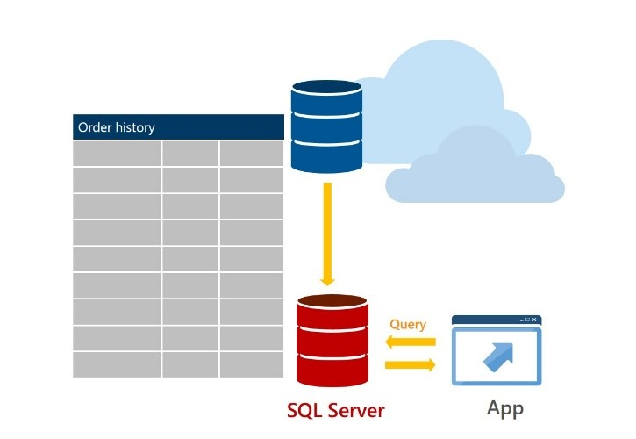
Stretch Database (2016)
https://msdn.microsoft.com/en-us/library/dn935011.aspx

Slide 51
Coming Soon

Slide 52
Elastic Database Pools
Available resources shared by the databases in the pool
Add/Remove databases any time.
Databases share resources eDTUs and storage
Each database uses only the resources it needs when it needs them, leaving resources free for other databases when they need them.

Slide 53
Elastic Database Jobs
Enables you to run T-SQL scripts (jobs) against all of the databases in an elastic database pool
Benefits
Define, maintain and persist T-SQL scripts to be executed across an elastic database pool
Execute T-SQL scripts reliably with automatic retry and at scale
Track job execution state
Scenarios
Performance administrative task, such as deploy new schema
Update reference data, for example product information common across all databases
Rebuild indexes to improve query performance

Slide 54
Wrap up

Slide 55
References
Client library and service packages are available on Nuget.org
Search for ‘Elastic Scale’ to find the projects on Nuget.org
Search for ‘Elastic Scale’ in the VS Package Manager to find the DLL
Client library: http://www.nuget.org/packages/Microsoft.Azure.SqlDatabase.ElasticScale.Client/
Split/Merge: http://www.nuget.org/packages/Microsoft.Azure.SqlDatabase.ElasticScale.Service.SplitMerge/
Documentation on Azure.com in the SQL Database section
Search for ‘elastic scale documentation map azure.com’
Get stared: http://azure.microsoft.com/en-us/documentation/articles/sql-database-elastic-scale-get-started/
Documentation map: http://azure.microsoft.com/en-us/documentation/articles/sql-database-elastic-scale-documentation-map/
Samples in the VS code samples gallery
Search for ‘Elastic Scale’ on https://code.msdn.microsoft.com/
Search for ‘Elastic Scale’ in the Online Samples section for new VS projects

Slide 56
In Review
Session Objectives:
Identify workloads and customers that will benefit from Elastic Scale in Azure SQL DB.
Help Azure SQL DB Federations customers migrate out off Federations.
Guide customers how to apply sharding to their data tiers.
Takeaway
Supported workloads can now freely scale in Azure SQL DB using Elastic Scale

Slide 57

Thank you! Your Feedback is Important
Rate My Talk & Download Slides!
http://bit.ly/RateShawnsTalk
(case sensitive)
Contact Information
Email: shawn@shawnweisfeld.com
Blog: http://www.shawnweisfeld.com
Twitter: @shawnweisfeld

Slide 58

© 2015 Microsoft Corporation. All rights reserved. Microsoft, Windows, Windows Vista and other product names are or may be registered trademarks and/or trademarks in the U.S. and/or other countries.
The information herein is for informational purposes only and represents the current view of Microsoft Corporation as of the date of this presentation. Because Microsoft must respond to changing market conditions, it should not be interpreted to be a commitment on the part of Microsoft, and Microsoft cannot guarantee the accuracy of any information provided after the date of this presentation. MICROSOFT MAKES NO WARRANTIES, EXPRESS, IMPLIED OR STATUTORY, AS TO THE INFORMATION IN THIS PRESENTATION.

